Slide 1
Nuclear Fusion
Mech 3 rd yr

Slide 2
Why Are We Interested?
There are great challenges that are associated with fusion, but there are also very large possible benefits
A coal power plant uses 9000 tons of coal a day to produce 1000 MW and emits many pollutants including 30,000 tons of carbon dioxide
A fusion power plant would use 2.5 pounds of deuterium and tritium for the same amount of power and would emit only 2 pounds of helium
The amount of lithium contained in a single computer battery along with about half of a bathtub full of water can produce as much energy as 40 tons of coal

Slide 3
What is Nuclear Fusion?
F
F
+
+
Fusion is the process of light atoms uniting to form heavier atoms
This releases energy
Nuclei are positively charged so they repel each other
Energy has to be input to overcome this repulsive force

Slide 4
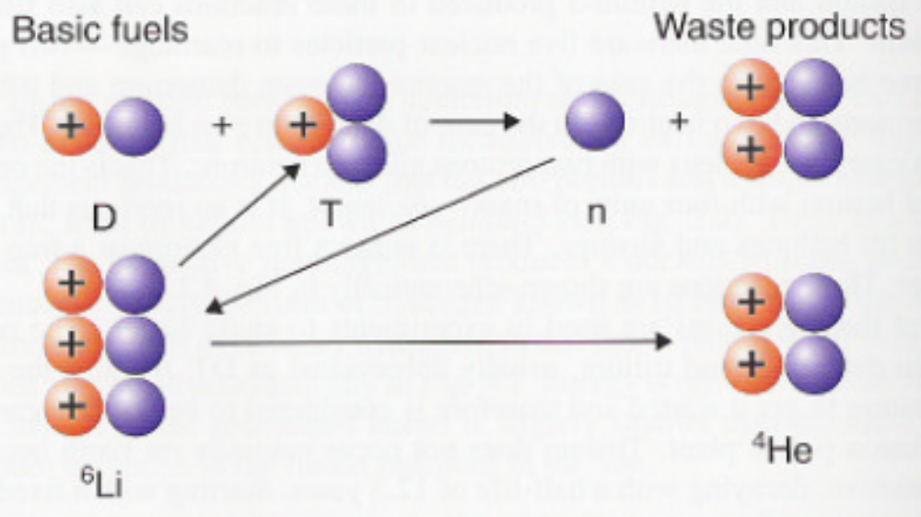
How Would Fusion Work?
1/7000th of hydrogen on Earth is deuterium so it will be extracted from seawater
Tritium will have to be bred on site
Carry McCracken and Peter Stott. Fusion the Energy of the Universe. Birlington: Elsevier Academic Press, 2005.

Slide 5
What are the Challenges?
For fusion to occur, reactor temperatures would have to be on the order of 200 million degrees Celsius
No material on earth can withstand 200 million degrees without melting
Two basic strategies:
1) Magnetic Confinement: Confine the plasma with magnetic fields so that the plasma will not touch the containment walls
2) Inertial Confinement: Supply large amounts of energy very quickly (i.e. shoot with lasers) so that the fuel is burned before it has time to expand and touch the walls

Slide 6
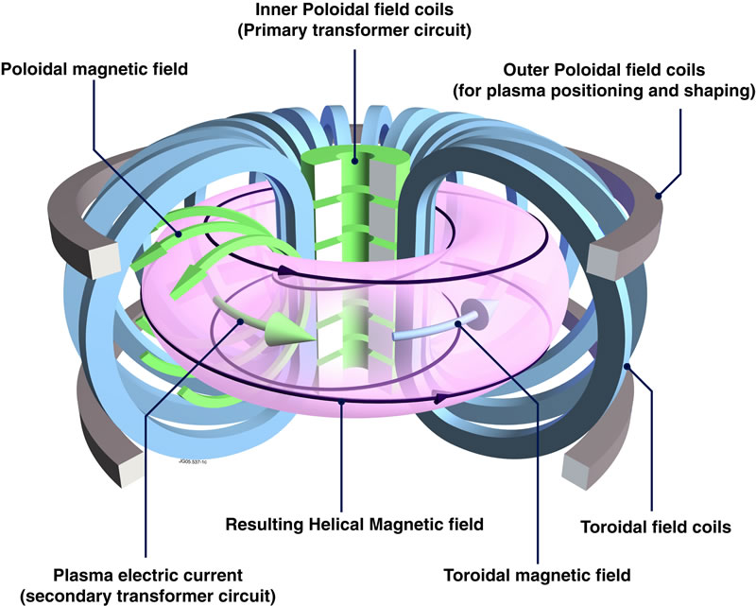
Magnetic Confinement: The Tokamak

Slide 7
What has been done?
Research has been going on since the 1940s
Current research efforts are very internationally based
The International Thermonuclear Experimental Reactor (ITER) will be built in France and is a collaboration between US, Europe, Japan, India, China, Russia, and Korea

Slide 8
What is the Goal?
Currently more energy has to be supplied to get the fusion reactions going than is output by fusion
Breakeven is the point in which the energy supplied equals or exceeds the energy output
Ignition is the point in which the energy from fusion supplies the heat necessary to sustain the reaction without external sources

Slide 9
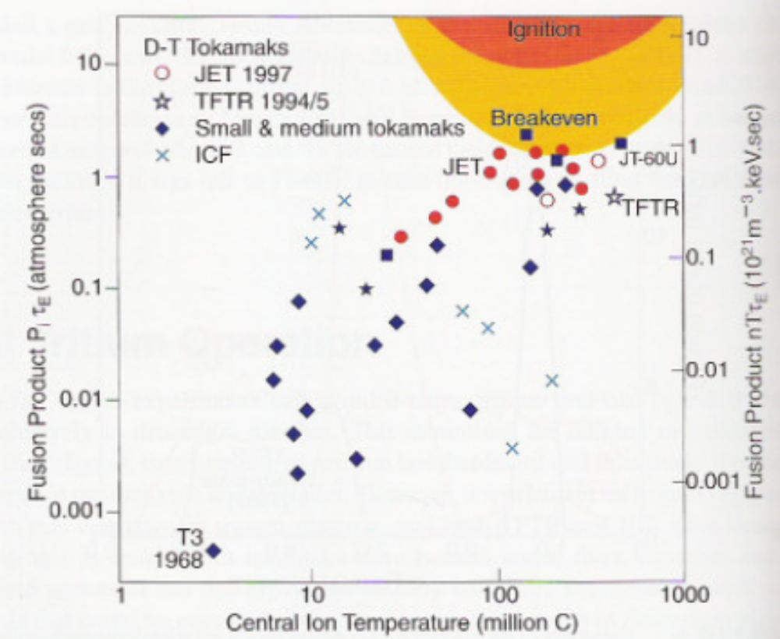
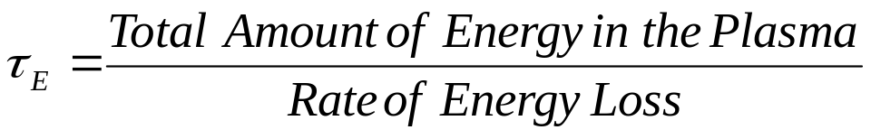
Will Fusion Work?
The product of the energy confinement time and pressure of the plasma as a function of temperature is the critical criterion for ignition
Breakeven has been reached
Ignition is the goal of ITER
Carry McCracken and Peter Stott. Fusion the Energy of the Universe. Birlington: Elsevier Academic Press, 2005.

Slide 10
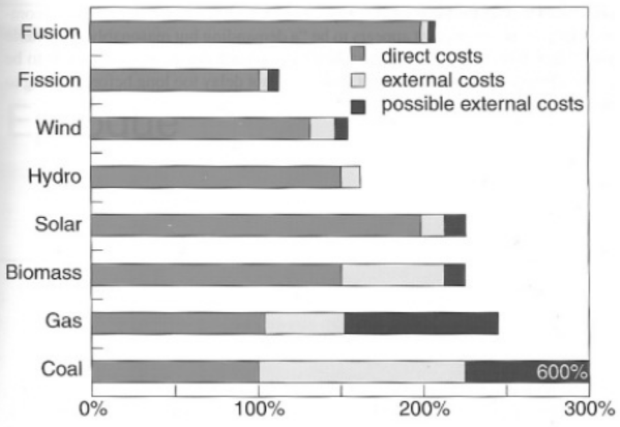
How Much Will Fusion Cost?
ITER will cost between $10-12 billion over 20 years.
  Europe: 4/11th
  Japan: 2/11th
  US, India, China,
  Russia, Korea: 1/11th

Slide 11
Is it Safe and Environmentally Friendly?
Fission reactors could meltdown because the fuel is in the reactor at all times and the reaction must be stopped to cool the reactor down
Fusion reactors cannot meltdown because there is very little fuel in the reactor at a time so to stop the reaction, the fuel valve can be closed or a “poison” valve can be opened to kill the reaction
Fission produces radioactive waste that needs to decay for 10,000 years before it can be buried
Neutrons cannot be confined in the magnetic field because they are uncharged so they will cause the first containment structure to be radioactive
The structure will only need to be stored for 100 years and constitutes much less material than nuclear fission

Slide 12
Questions?

